Slide 1
PMW 1: Analysis & Reporting of QTc Prolongation Potential of New Drugs Using R Tools, Expectations & General
Guidance for Regulatory Submissions

Slide 2
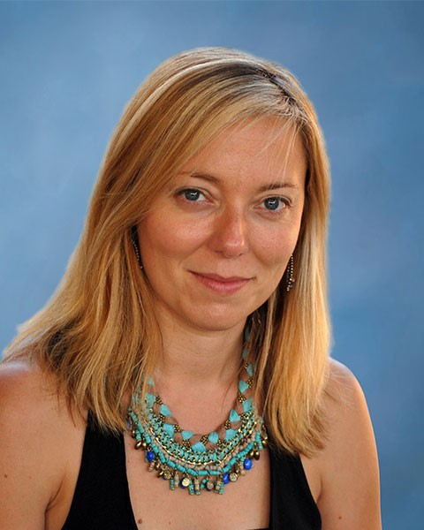
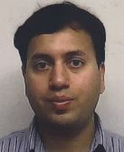
Session Co-Chair:
Ana Ruiz-Garcia, PharmD, PhD, Senior Principal Scientist I, Metrum Research Group LLC
Session Co-Chair:
Dhananjay D. Marathe, PhD, Principal Scientist, Quantitative Pharmacology & Pharmacometrics, Merck & Co Inc

Slide 3
Financial Disclosures
Ana Ruiz-Garcia, PharmD, PhD: employee-Metrum Research Group
Dhananjay D. Marathe, PhD: employee-Merck & Co Inc
Steve Riley, PharmD, PhD: employee-Pfizer, Inc

Slide 4
GOALS & OBJECTIVES
Following the completion of this activity, the learner will be able to:
Become familiar with the ECG-pharmacokinetic analysis using R;
Create a report using R Markdown;
Gain understanding about the sample size and exposure margin requirements for TQT substitution request based on studies without a positive control;
Have a deeper understanding of some of the common challenges and potential solutions for design/analysis issues.

Slide 5
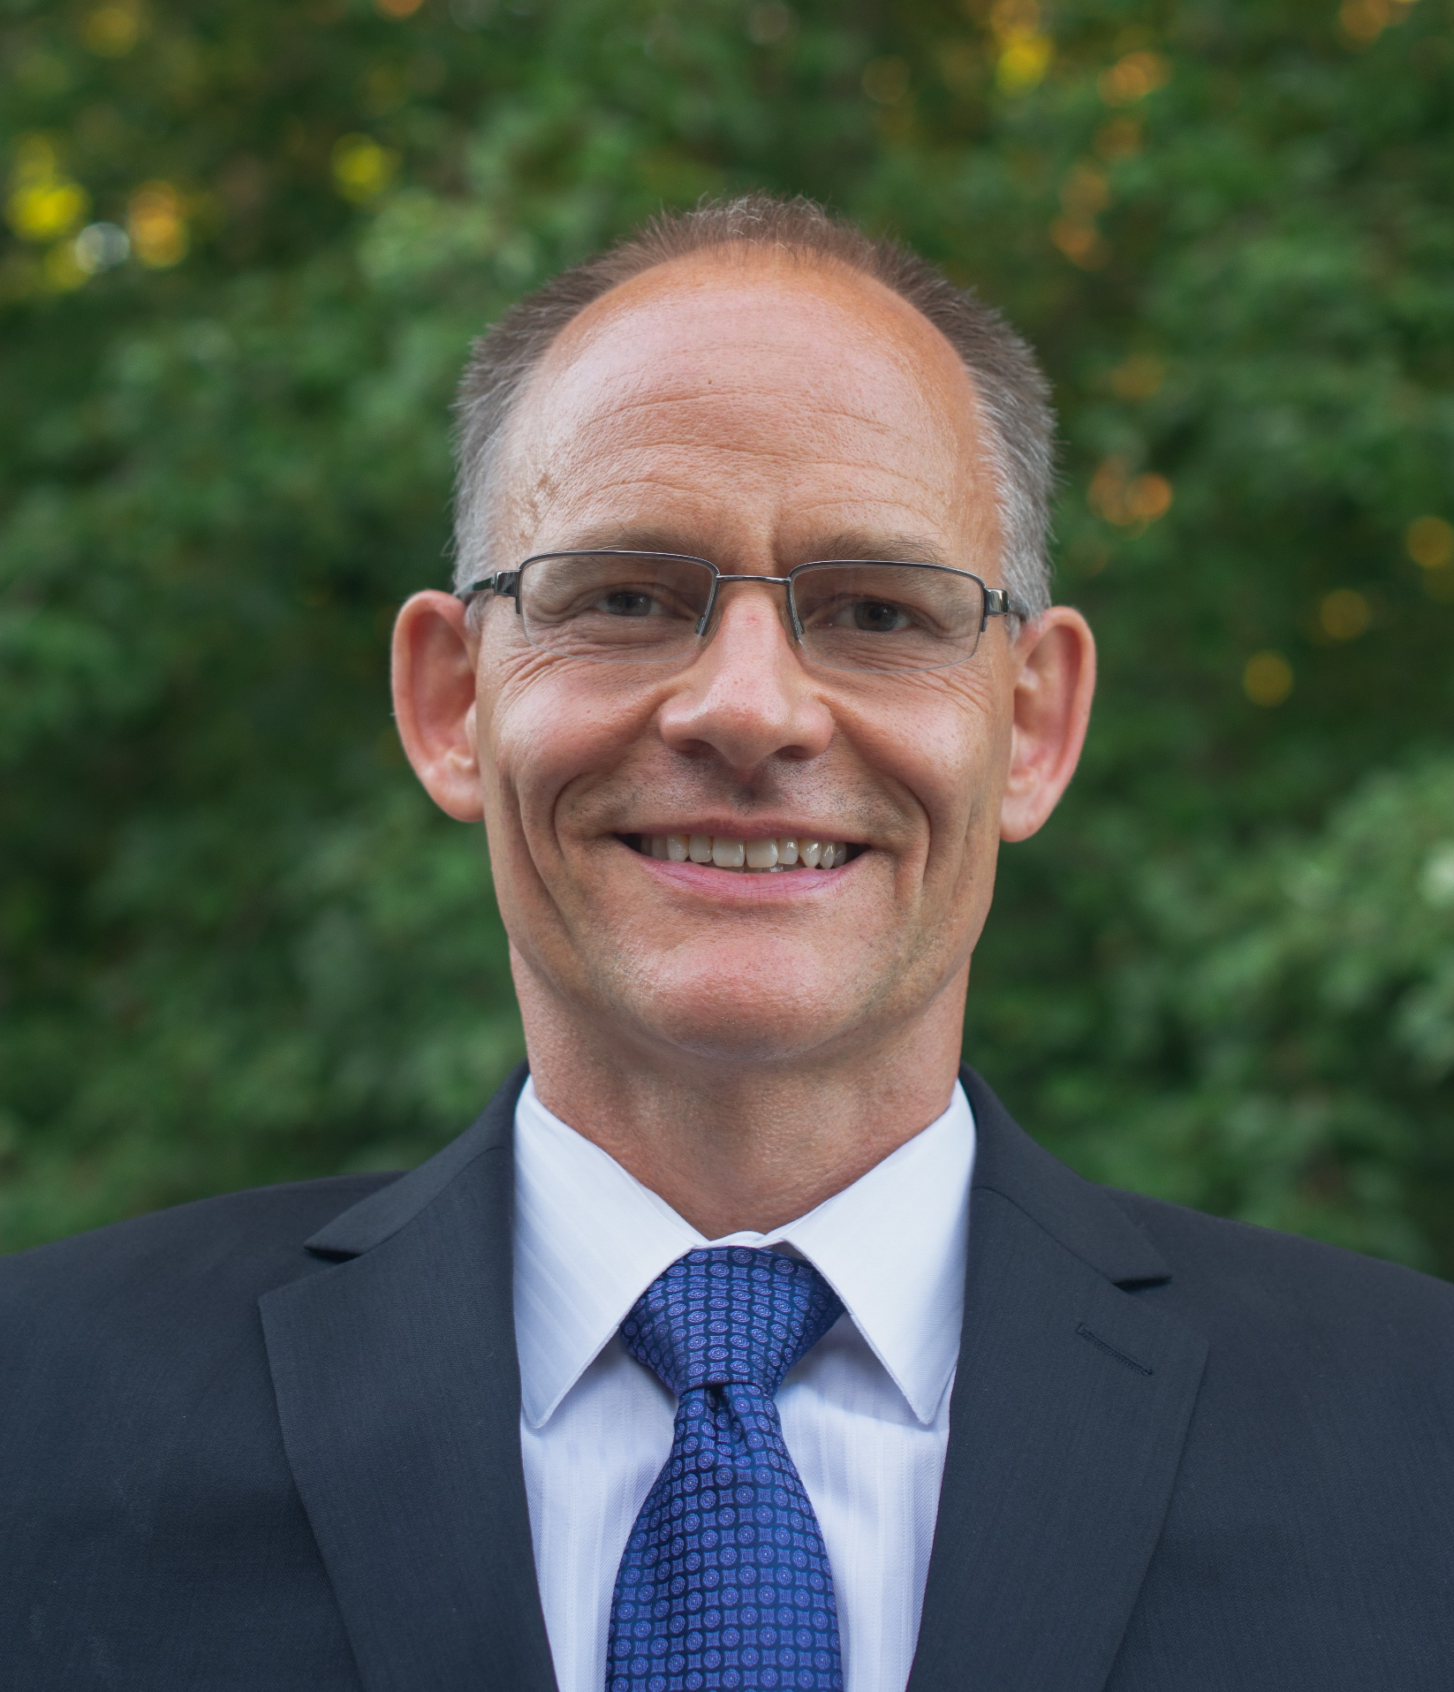
Introduction of Faculty: Steve Riley, PharmD, PhD
Senior Director, Clinical Pharmacology, Pfizer Inc

Slide 6
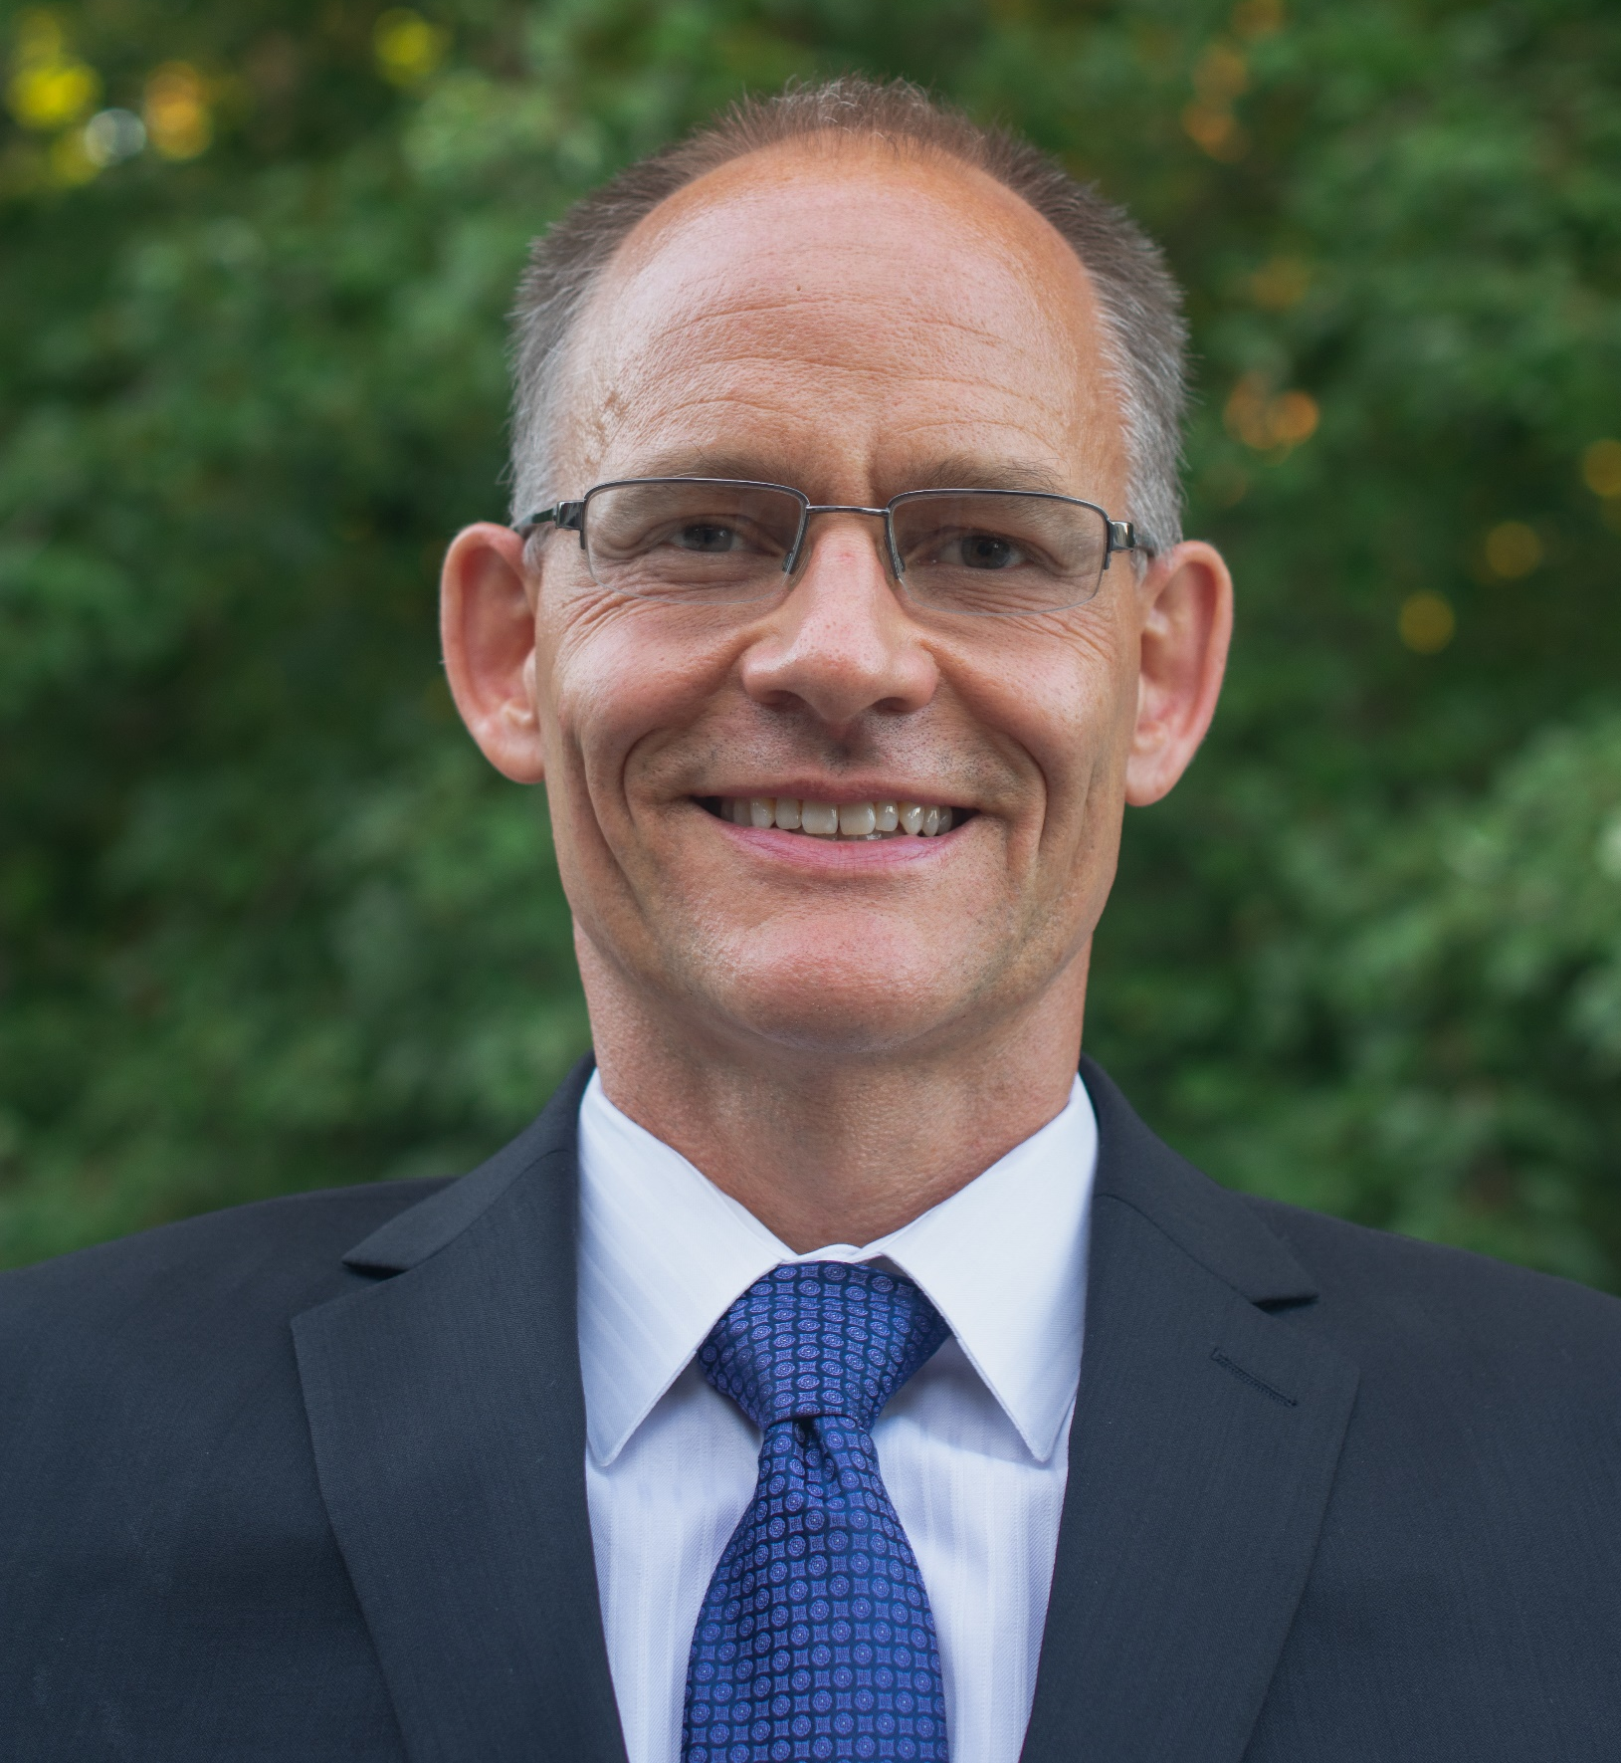
Faculty Panel Discussion, Questions & Answers

